Slide 1
Capstone Project
www.collaberadigital.com

Slide 2
Personal BACKGROUND
(Name, Past Experience, Qualification, Career Summary)
Name : Cabilla, Homer Garnet
Past Experience : .Net Developer 9months
Qualification : Angular, AngularJs, .Net Mvc .Net core 3.0 Web API, Sql Server 2019, Github
Career Summary : A web developer specialize in .Net technologies and Angular framework for frontend focus in fixing bugs that appear in our ticketing system and attend Daily Stand Up meeting for the clients needs.
Front end using angular framework
Back End using dotnet core (entity framework) core,Maintaining System
Fixing UI, Creating API, Updating the API
Deploy in AWS elastic beans talk
Deploy Angular in s3 aws
Deploy in

Slide 3
Key Takeaways/Learnings from the Program (HTD)
(Ideas inserted here; paraphrase if needed)
Java Spring Framework commands are comparable to REST Controller/Task commands (or insert other language equivalent if you have comparisons)Put here why or how they are comparable.With the Spring Framework, the terms entity, DAO, and JPA are also interchangeable.
OOTB features (Controller/Task Commands, UI) customization/extension
Adapting the tax logic to your business's needs by extending the OOTB commands
Architecture for WCS8 and WCS9Architecture variations between versions 8.0 and 9.0
Typical WCS programming development flowderived from OOTB features like Controller instructions that are already in place.
Utilities WCSDataloadingManagement OfficeAdministrator/Accelerator Console

Slide 4
Solr Indexing
Building the index through the cmd
Checking the index in browser using the link
General Troubleshooting
Improvement on the habit of checking consoles to identify the problem in the code (example gen. troubleshooting takeaway)
Extending Views
Views-ext.xml
Hidden OOTB Fields for Developer-Custom-Data
Example: ORDERITEMEXTATTR for additional custom data for item order
Access Control Policy
Managing ACP’s for commands like controller commands

Slide 5
Step 1
Edit wc-dataload-env.xml, wc-loader-catalog-entry-update.xml
wc-dataload-catalog-entry-update.xml
CatalogEntriesUpdate.csv
run this in cmd (Make sure it is on administrator mode for avoiding permission denied)
C:\WCDE_V9\bin>dataload.bat C:\dataload\CatalogEntryUpdate\wc-dataload-catalog-entry-update.xml
Step 2
In x-schema.xml add two fields, productRanking, productRankingDisplay

Slide 6
In x-data-config.xml, add two field column PRODUCT_RATING, RATING_COMPANY
<!-- Custom -->
<field column="PRODUCT_RATING" name="productRanking" />
<field column="RATING_COMPANY" name="ratingCompany" />
In wc-dataimport-preprocess-xfinalfuild.xml

Slide 7
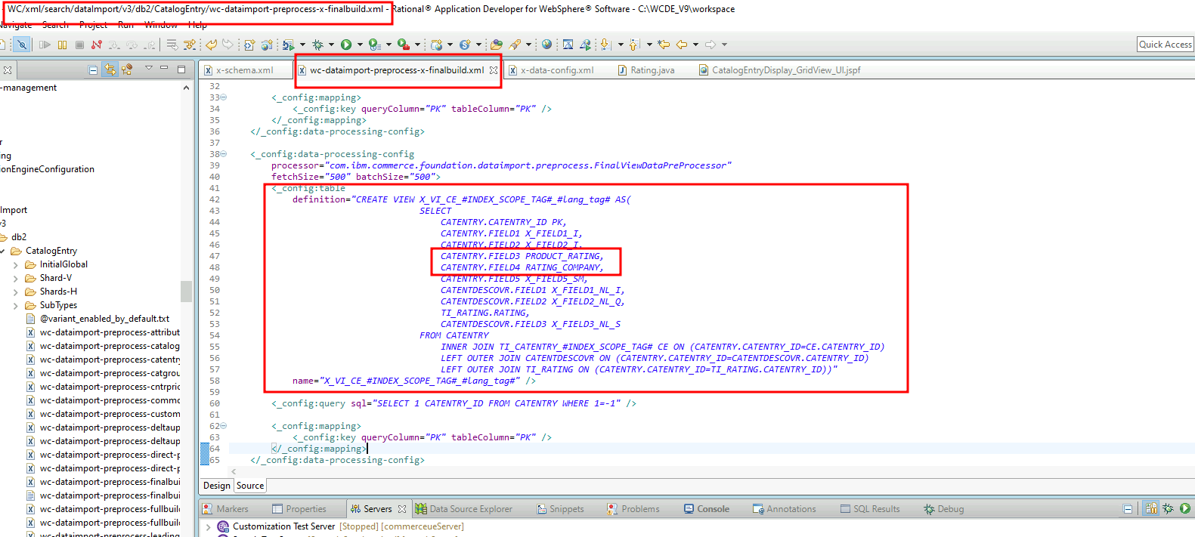
Create a <_config:table> element and define the catentry

Slide 8
restart Search test server (if not working, restart the servers)do build index
curl --user spiuser:passw0rd --insecure -X POST https://localhost:443/wcs/resources/admin/index/dataImport/build?masterCatalogId=10001
curl --user spiuser:passw0rd --insecure -X GET https://localhost:443/wcs/resources/admin/index/dataImport/status?jobStatusId=<status id of out of cmd>

Slide 9
go to solr
http://localhost:3737/solr/MC_10001_CatalogEntry_en_US/select?q=catentry_id:<your part number in step 1 in dataloader "CatalogEntriesUpdate.csv">

Slide 10


In CatalogEntryDisplay_GridView_UI.jspf
put the condition of the following:
<c:out value=“Product Ranking: ${catalogEntryDetails.UserData[0].x_productRanking}” />
<c:out value=“Company Rating : ${catalogEntryDetails.UserData[0].x_companyRating}” />
Step 3
Initialize the attribute dictionary in wc-loader-catalog.xml
<_Config:property name=“initAttributeDictionary” value=“true” />
In wc-loader-catalog-entry.xml
<_Config:property name=“initAttributeDictionary”
value=“true” />
Save and close the file.
www.collaberadigital.com

Slide 11
I go to the directory C:\WCDE_V9\samples\DataLoad\Catalog\AttributeDictionaryAttribute
to reused and dataload The AttributeDictionaryAttributeAndAllowedValues.csv and CatalogEntryAttributeDictionaryAttributeRelationship.csv. I change the wc-dataload-env located at C:\WCDE_V9\samples\DataLoad\Catalog
next is i change the AttributeDictionaryAttributeAndAllowedValues.csv
next is I change CatalogEntryAttributeDictionaryAttributeRelationship.csv
next is run the dataload located at C:\WCDE_V9\samples\DataLoad\Catalog\AttributeDictionaryAttribute
TAKE NOTE: To run dataload, the cmd must be on administrator mode and it should be in the directory of C:\WCDE_V9\bin
then run the command dataload.bat C:\WCDE_V9\samples\DataLoad\Catalog\AttributeDictionaryAttribute\wc-dataload.xml

Slide 12
needs to restart the search server
int cmd, do build index
curl --user spiuser:passw0rd --insecure -X POST https://localhost:443/wcs/resources/admin/index/dataImport/build?masterCatalogId=10001
Step4: On PDP page Add product to basket
Step 5: allow customer to add gift wrap service
) Go to ShopperActions_UI.jspf
2.) Get the source code of DescriptiveAttributes_Data.jspf
and paste the conditions here in ShopperActions_Data.jspf
3.) To insert the data to ORDITEMEXTATTR table, you must put the following code below:
(We see it in swagger ui documentation:)
{attributeName: 'Gift Wrap Message', attributeValue: $('#txtgiftMessage').val()}

Slide 13
Step6: On Order confirmation: display if gift wrap service was selected by customer and display the gift message
1.) To display in the Shopping Cart List,
you must include the following code in OrderItemDetail.jsp in the directory of crs-web -> WebContent -> AuroraStorefrontAssetStore/Snippets -> Order -> Cart:
<!-- Gift Wrap message START -->
<c:if test="${!empty orderItem.orderItemExtendAttribute}">
<span>Availed Gift Wrapping Service: Yes</span><br/>
<span>Gift Message: <c:out value="${orderItem.orderItemExtendAttribute[0].attributeValue}" /></span><br/>
</c:if>
<!-- Gift Wrap message END -->
2.) Also display in the Shipping & Billing Method
2.) Also display in the Order Summary

Slide 14
Part 2 Step 1:
Complete User registration : add 2 fields
User favourite colour
favourite food
Save in custom table, using JPA. Extend the user registration command
Create a custom web page
UserFavorites.jsp located at
crs-web/WebContent/AuroraStorefrontAssetStore/UserArea/AccountSection
Register the url and the bean in views-ext.xml
Create Handler named “FavoriteHandler.java” located at WebSphereCommerceServerExtensionsLogic
Register the package name of your created Handler
In resources-ext.properties located at Rest/WebContent/WEB-INF/config

Slide 15
Create a rest-template-config.xml a new resources located at crs-web/WebContent/WEB-INF/xml/config
And create new folder name “com.abc.commerce.favorites”
In controllers.ext, Apply the declared resource on rest-template-config as parameter
And register the url and the bean.
Create a Command Controller and Command Implementation Controller for Saving information of user favorite color and food
Create a Task Command Controller and Task Command Implementation Controller for Saving information of user favorite color and food
Create a Command Controller and Command Implementation Controller for Getting information of user favorite color and food
Create a Task Command Controller and Task Command Implementation Controller for Getting information of user favorite color and food

Slide 16
Create Data Access Bean, DAO, Entity Class for Users Favorite
Create a bean mapping

Slide 17
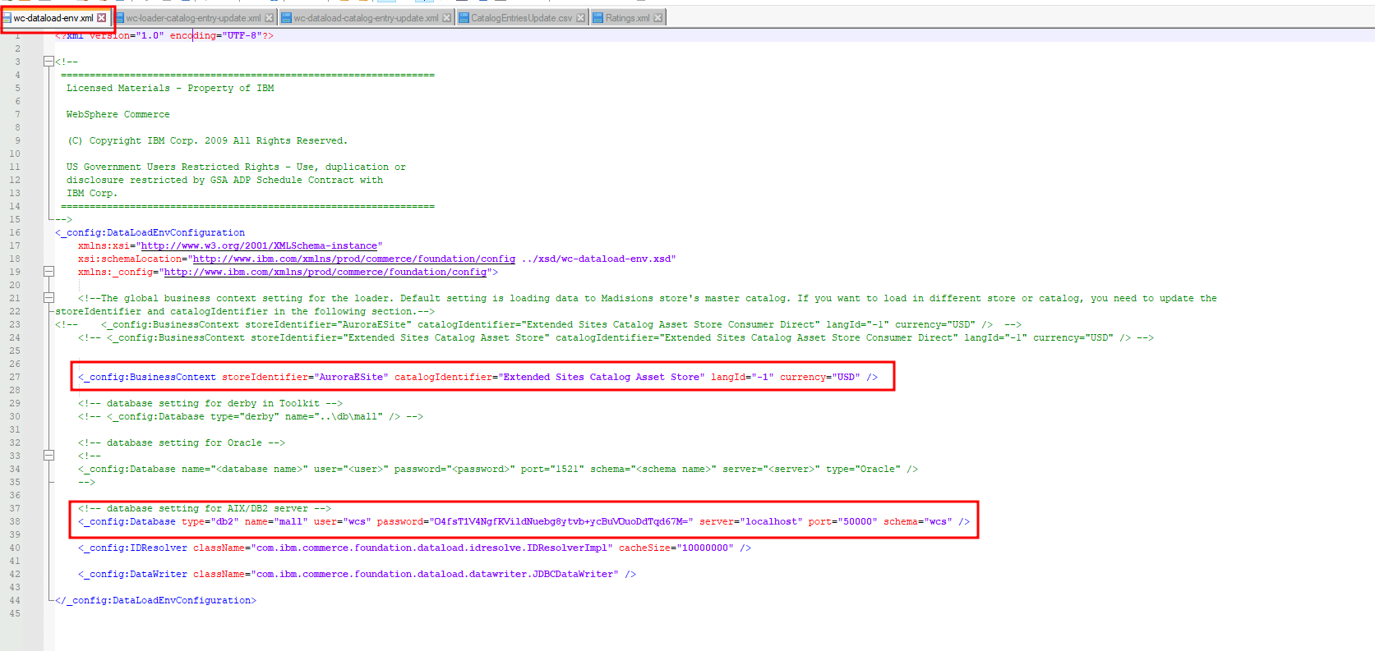
Important areas of the Project Step 1

Slide 18
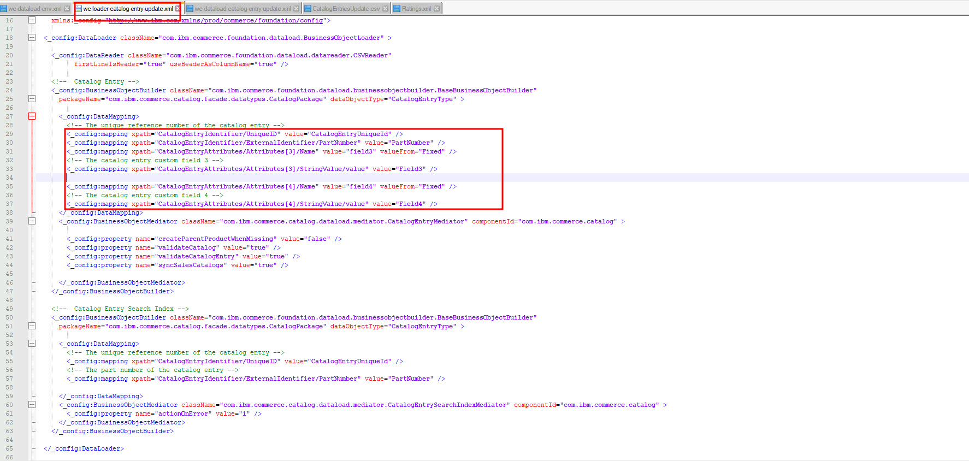
Important areas of the Project Step 1

Slide 19
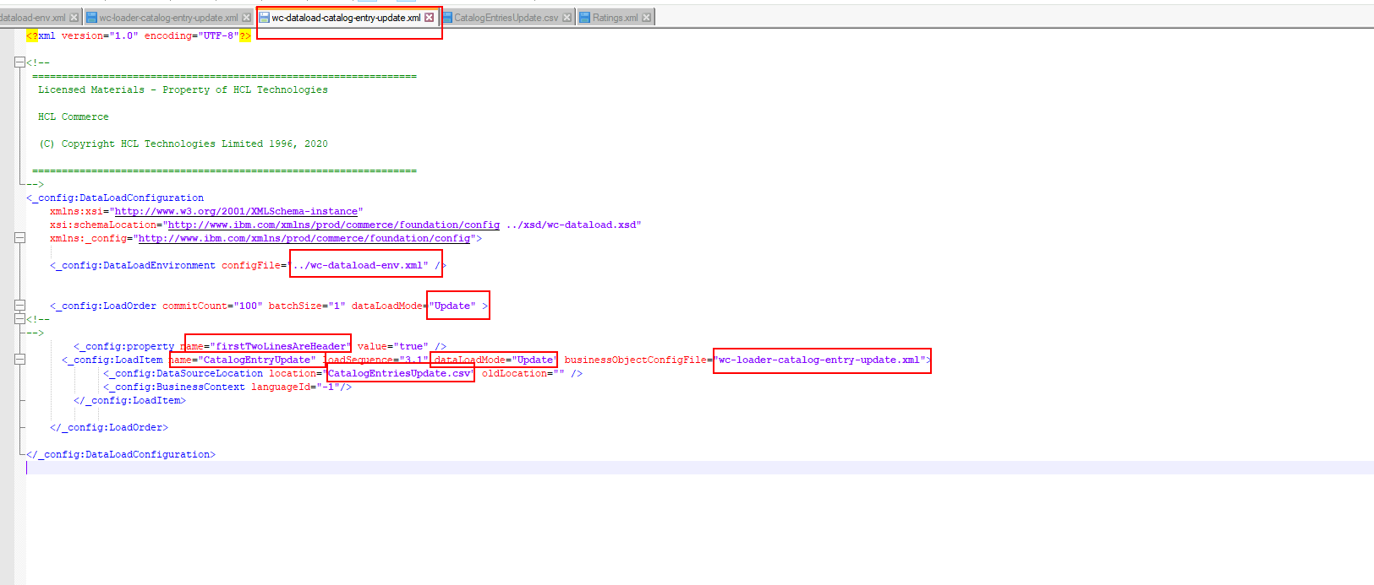
Important areas of the Project Step 1

Slide 20
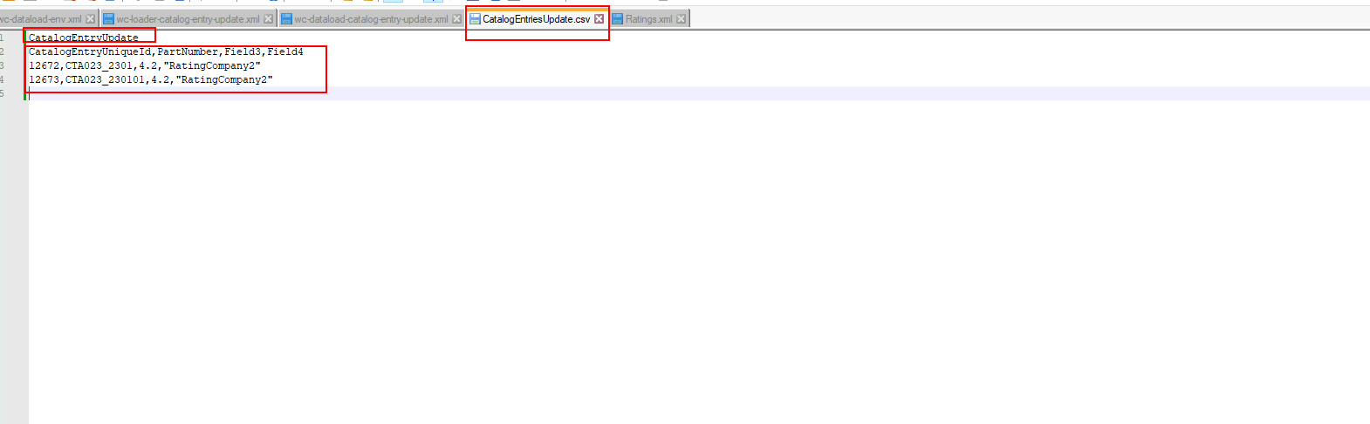
Important areas of the Project Step 1

Slide 21
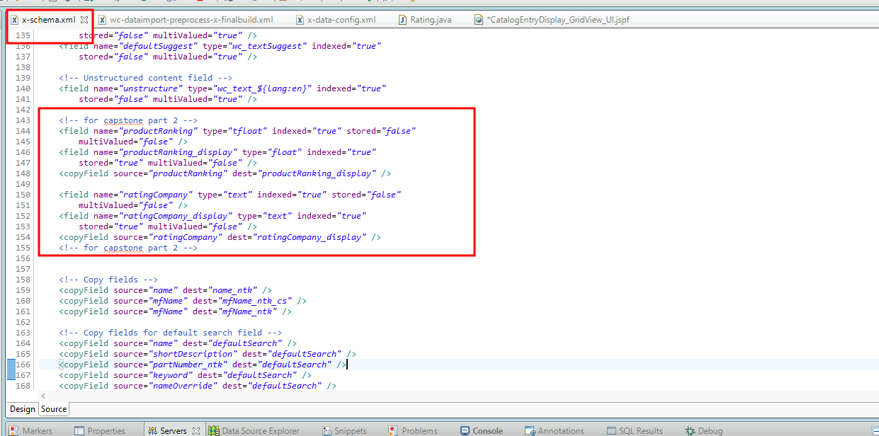
Important areas of the Project Step 2

Slide 22
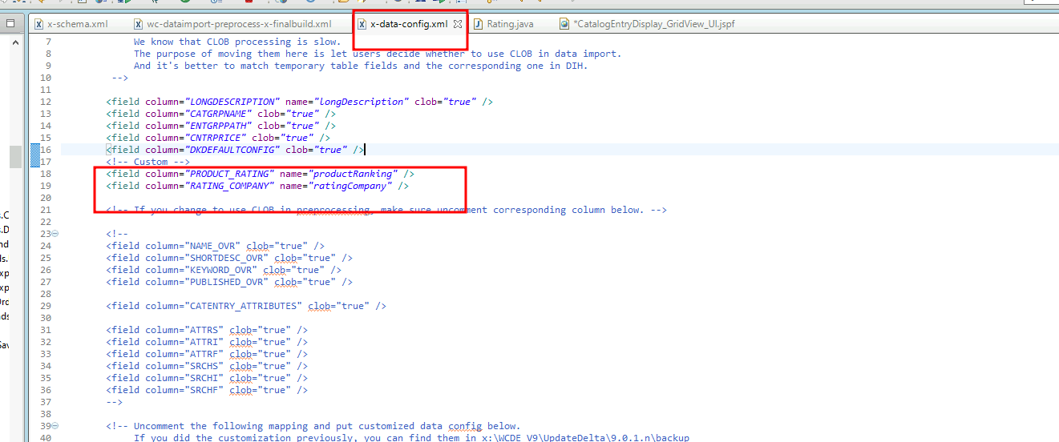
Important areas of the Project Step 2

Slide 23
Important areas of the Project Step 2

Slide 24
Important areas of the Project Step 2

Slide 25
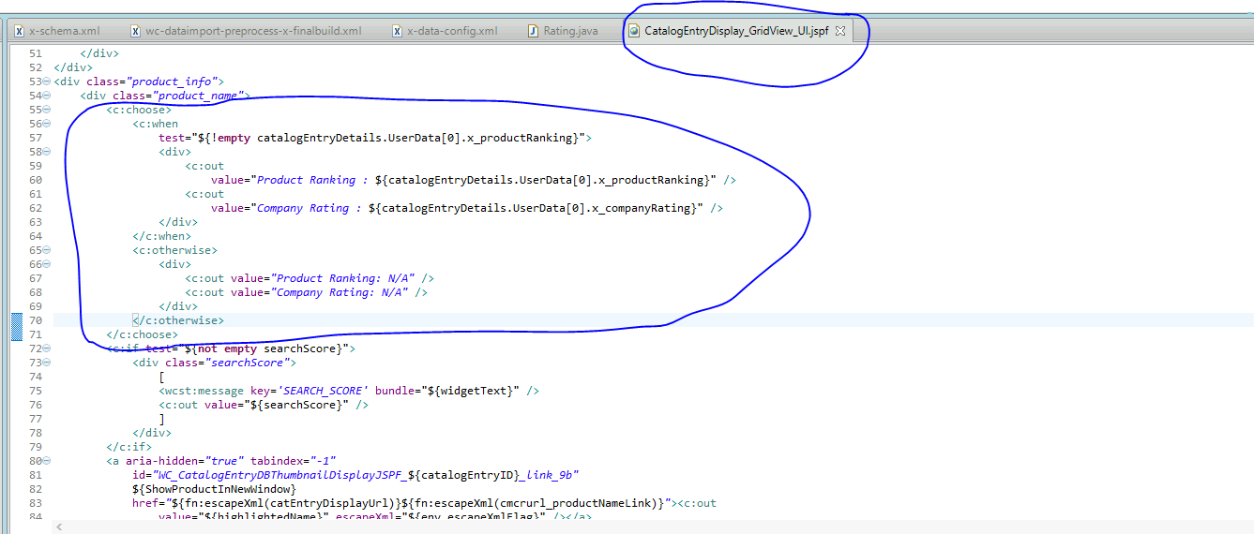
Important areas of the Project Step 2

Slide 26
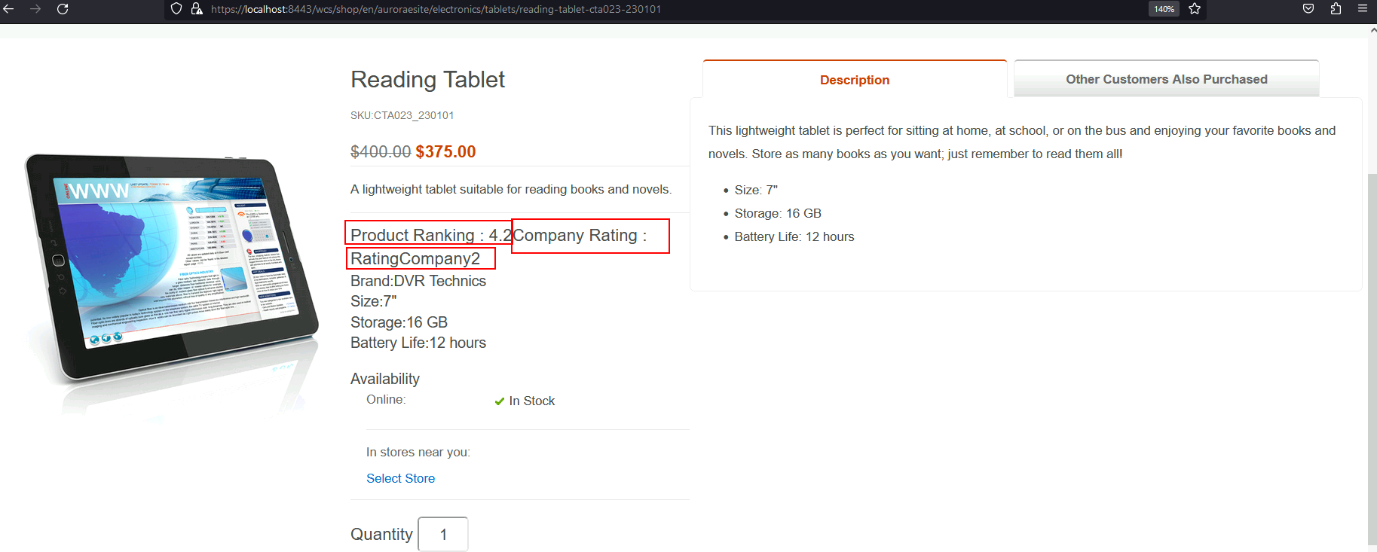
Important areas of the Project Step 2
OUTPUT

Slide 27
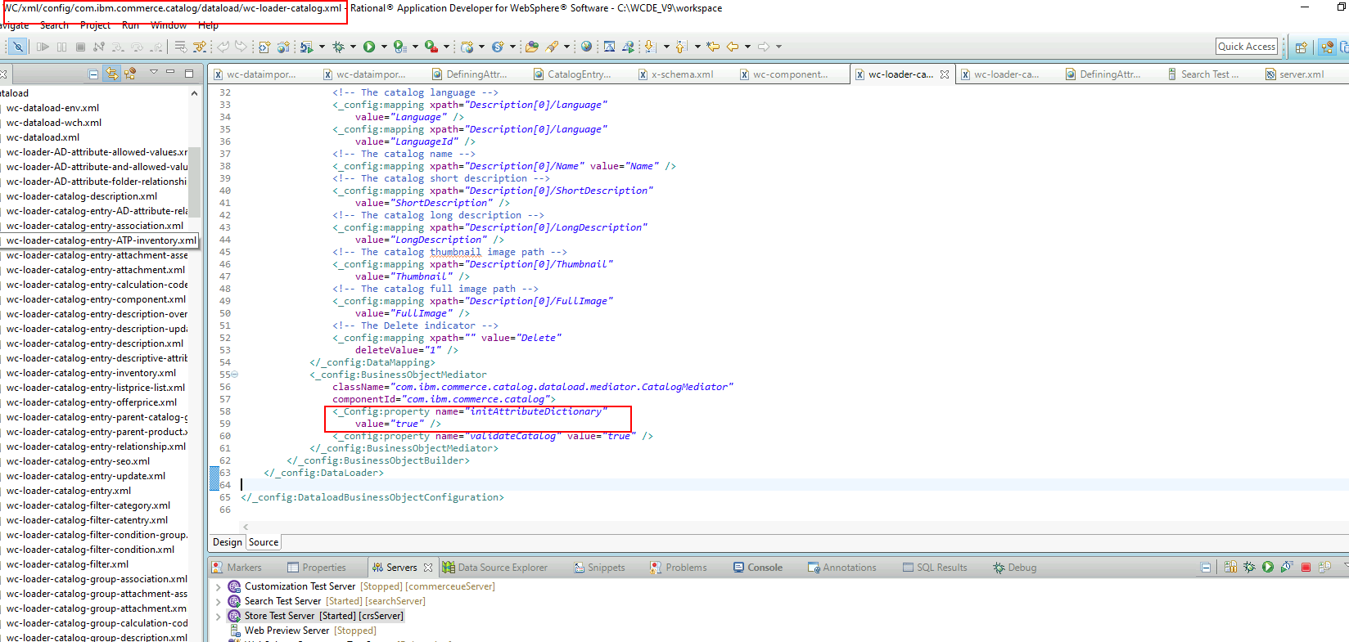
Important areas of the Project Step 3

Slide 28
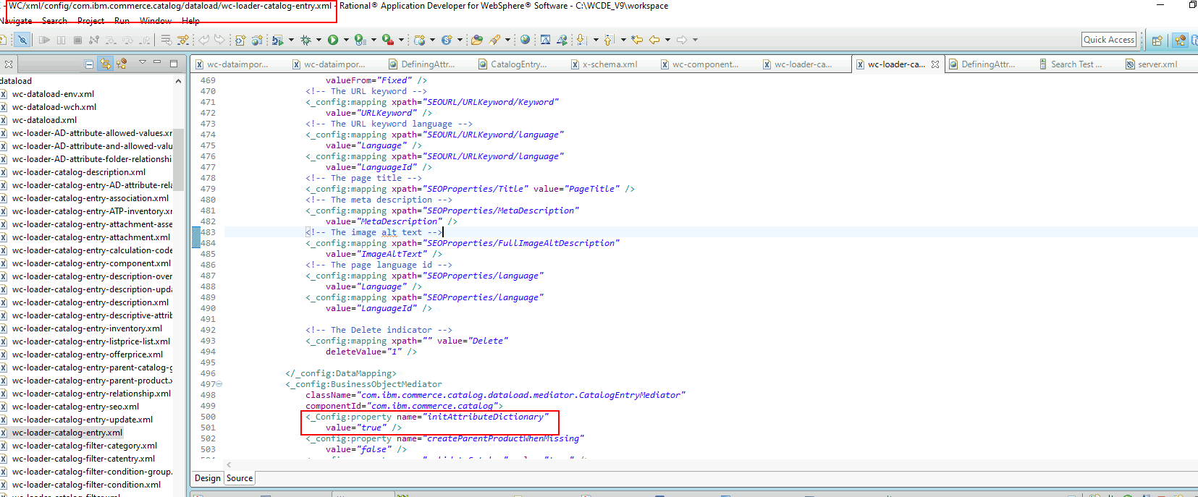
Important areas of the Project Step 3

Slide 29
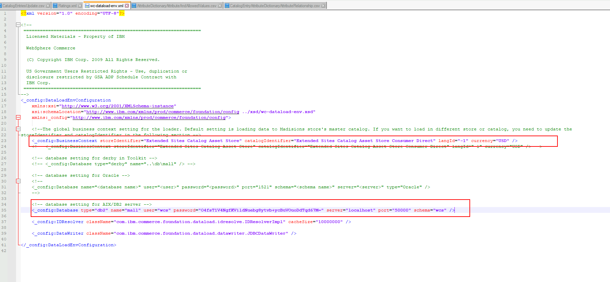
Important areas of the Project Step 3

Slide 30
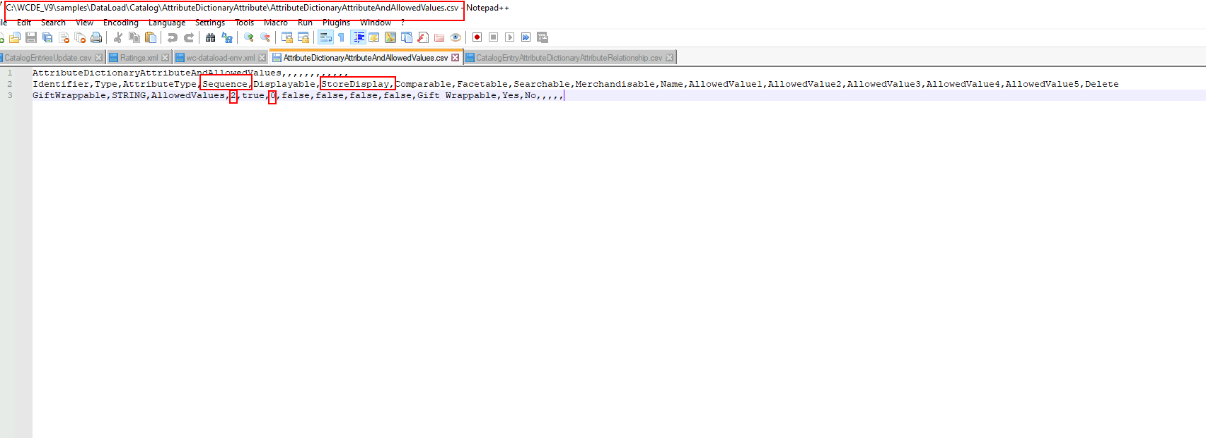
Important areas of the Project Step 3

Slide 31
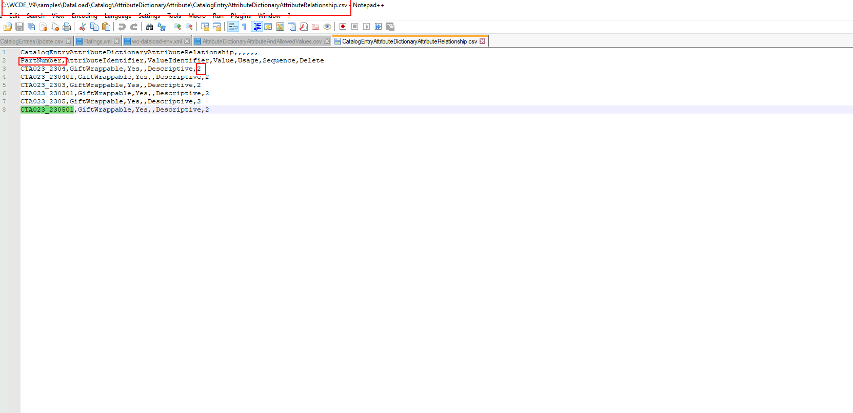
Important areas of the Project Step 3

Slide 32
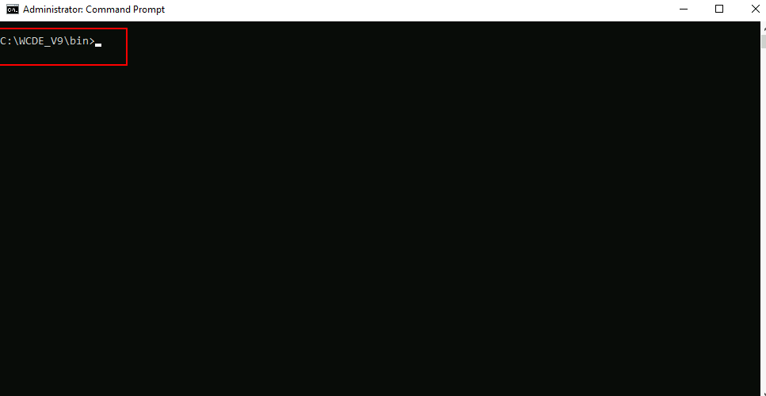
Important areas of the Project Step 3

Slide 33
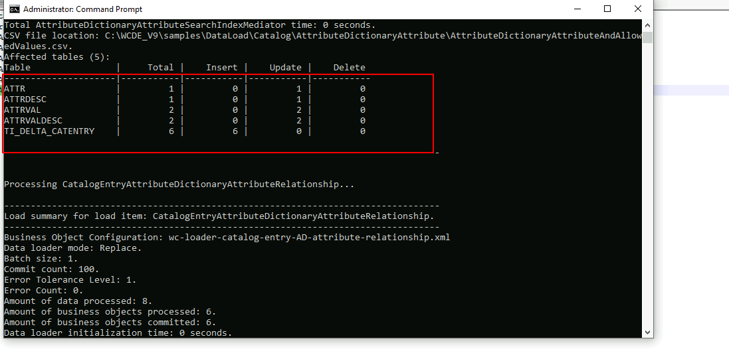
Important areas of the Project Step 3

Slide 34
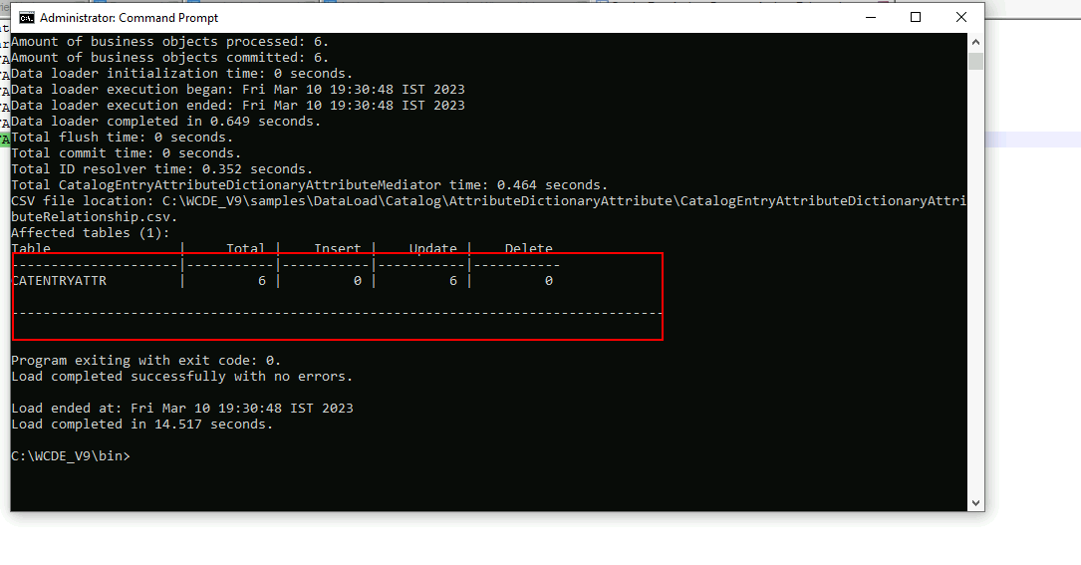
Important areas of the Project Step 3

Slide 35
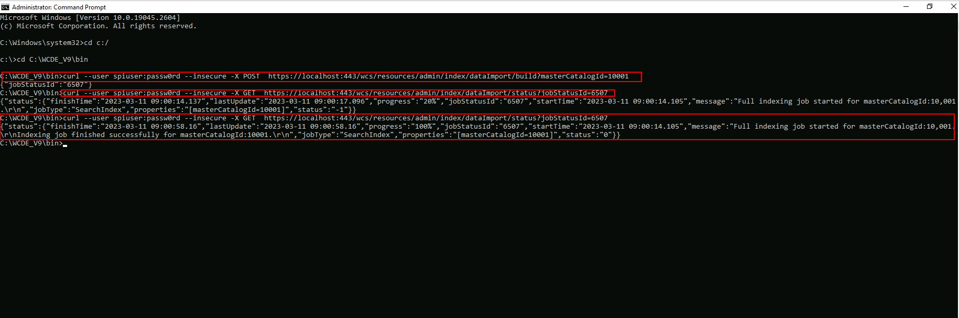
Important areas of the Project Step 3

Slide 36
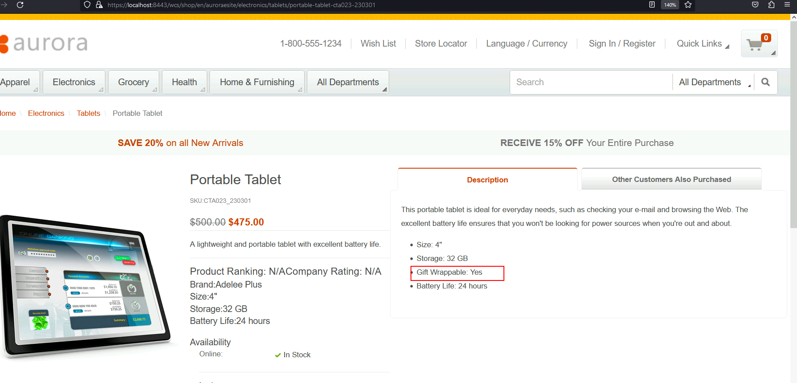
Important areas of the Project Step 3
OUTPUT

Slide 37
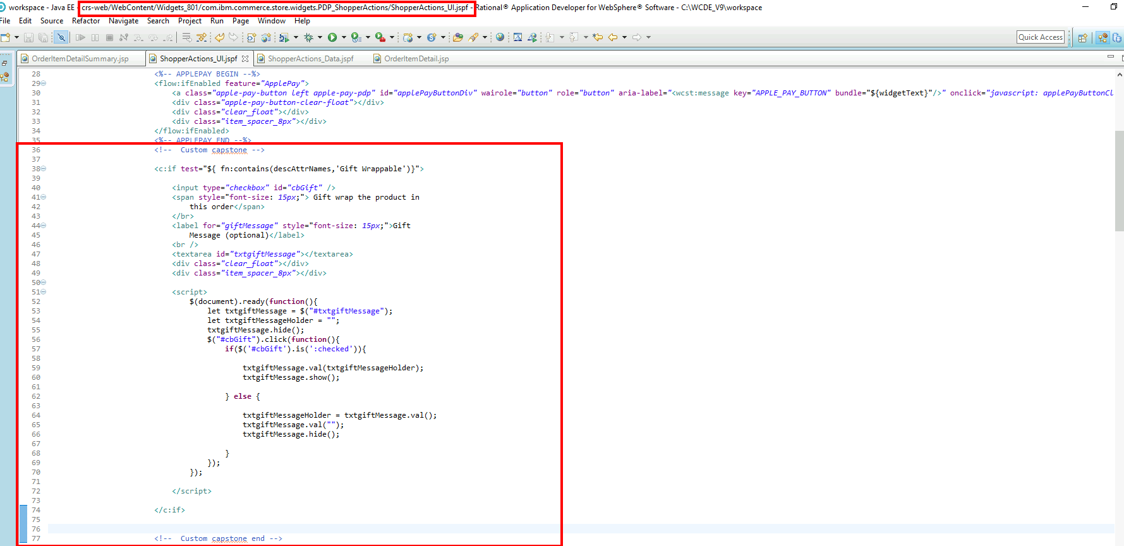
Important areas of the Project Step 5

Slide 38
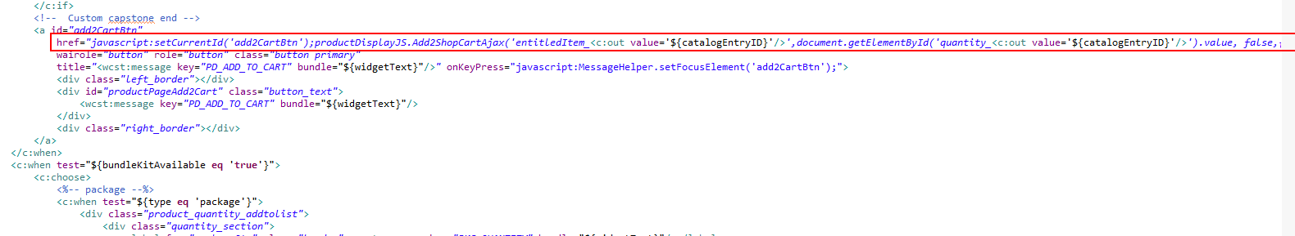
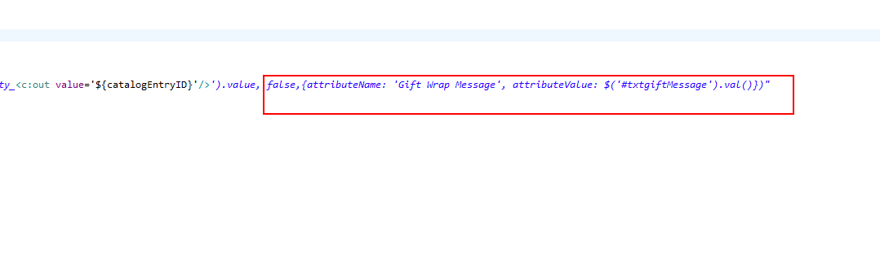
Important areas of the Project Step 5

Slide 39
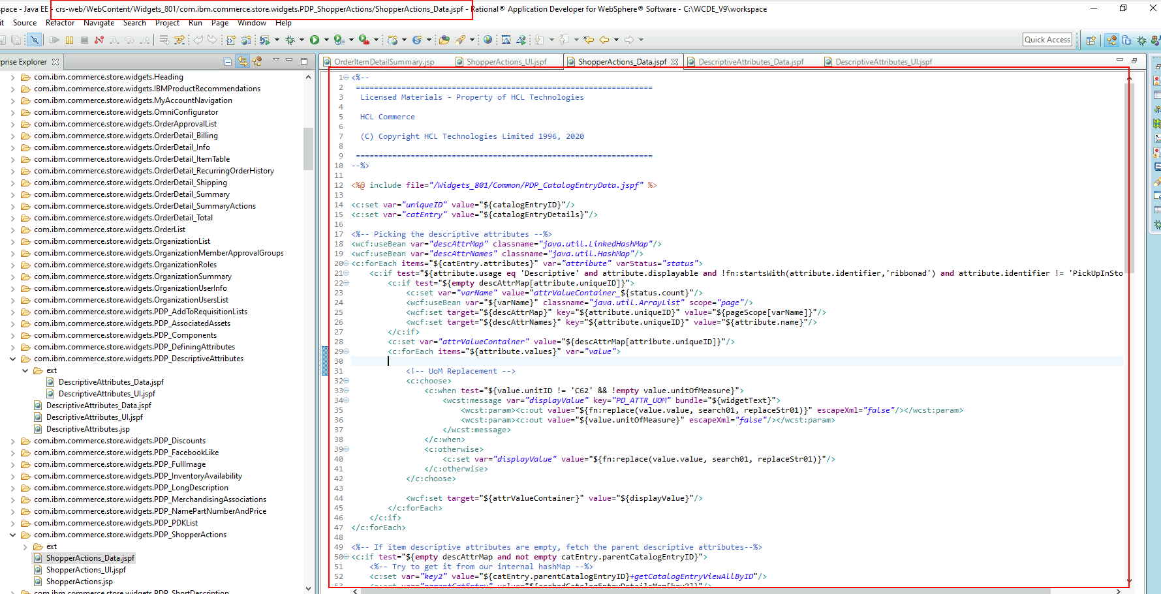
Important areas of the Project Step 5

Slide 40
Important areas of the Project Step 5

Slide 41
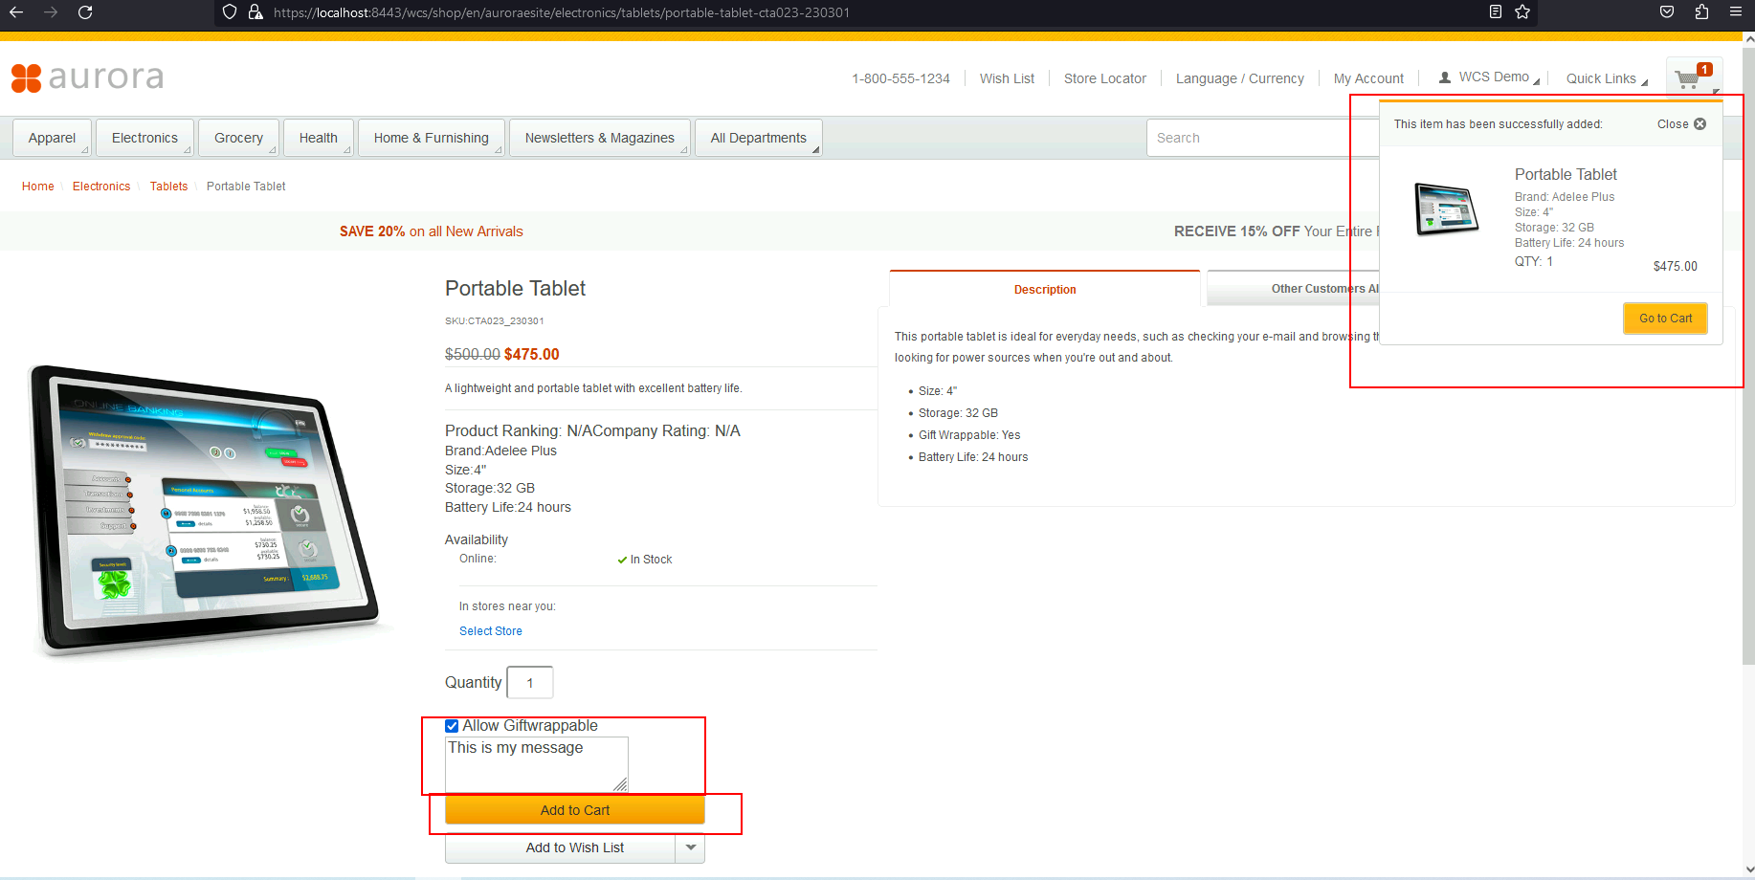
Important areas of the Project Step 5
OUTPUT 1

Slide 42
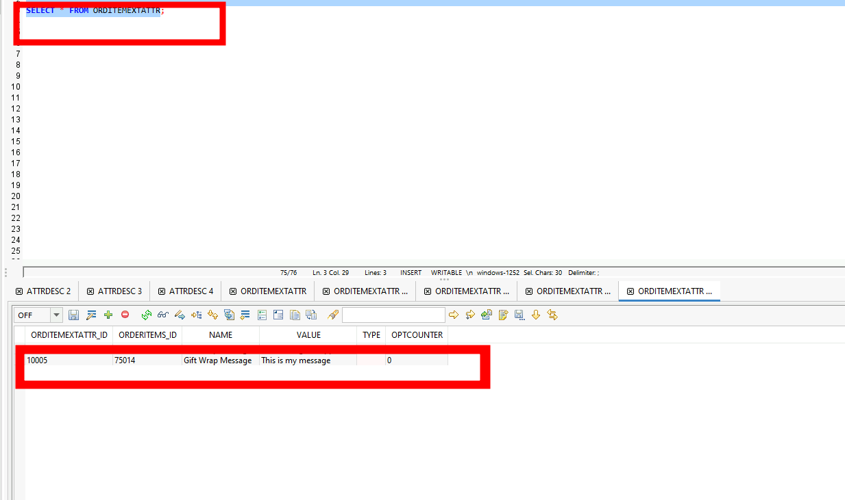
Important areas of the Project Step 5
OUTPUT 2

Slide 43
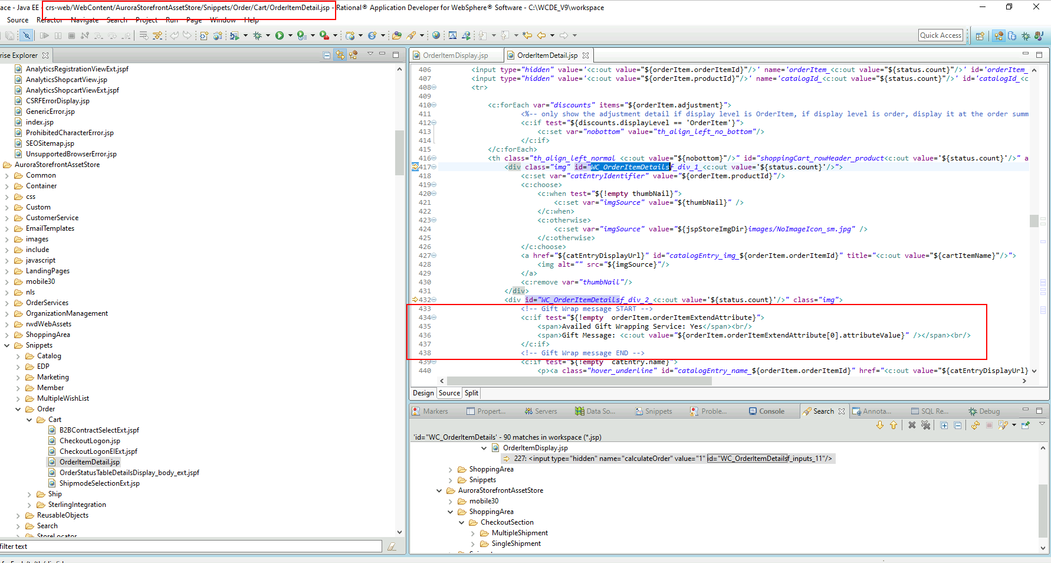
Important areas of the Project Step 6

Slide 44
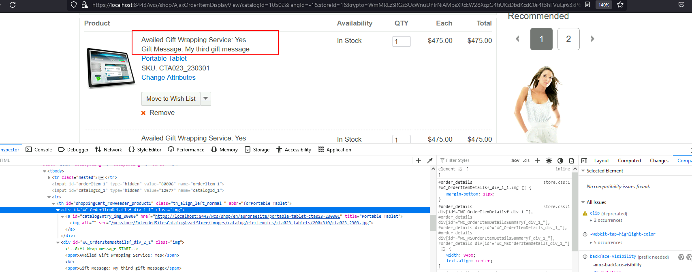
Important areas of the Project Step 6

Slide 45
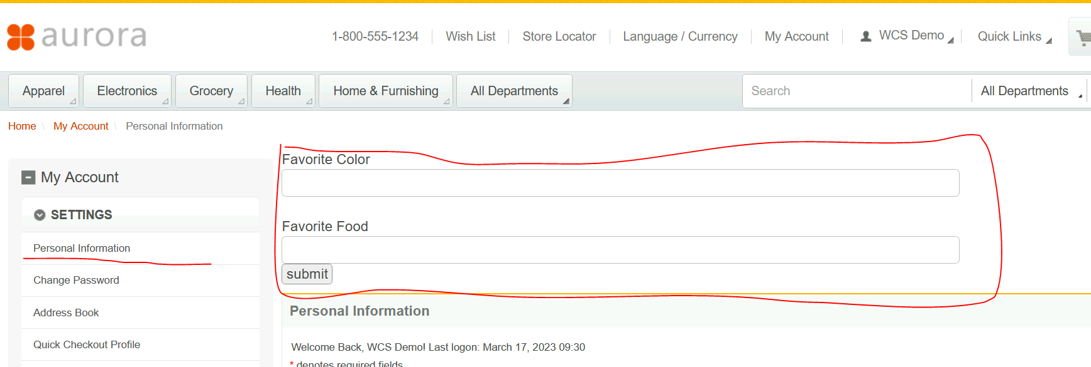
Important areas of the Project Step 2

Slide 46
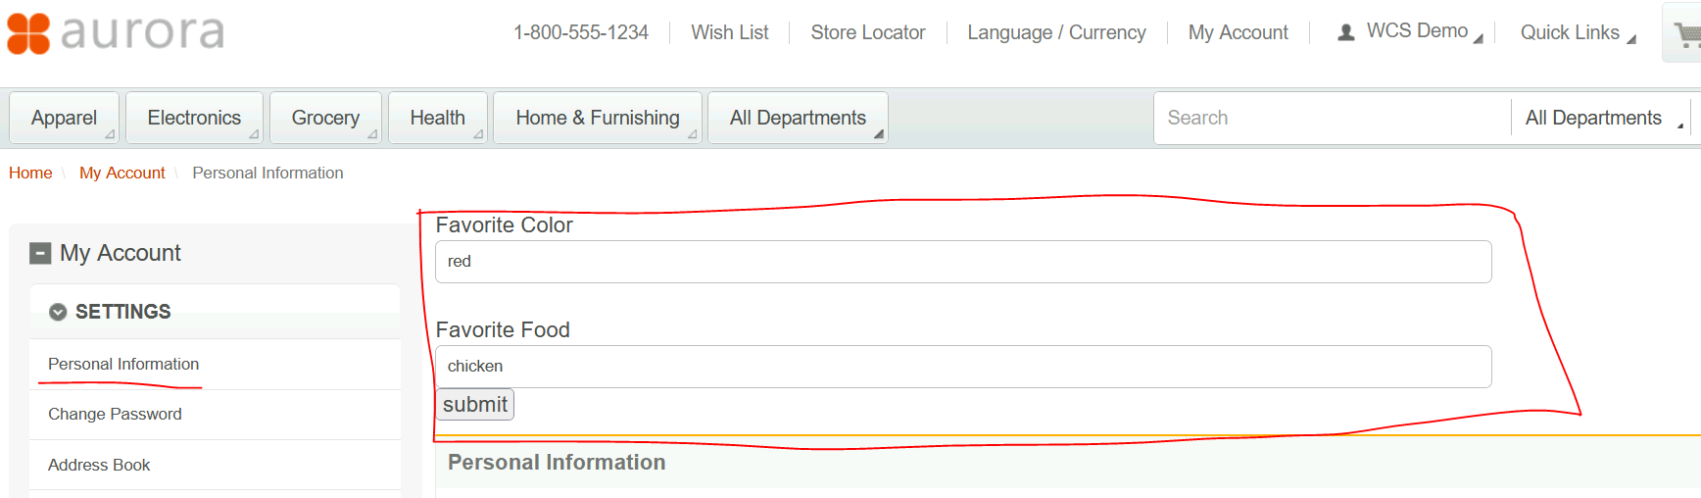
Important areas of the Project Step 2

Slide 47
Conclusion
The training was a step by step solution and modification that are mostly done by HCL developer on a daily basis. I learn Customization of add to cart, data loading, understanding of workflow by this, it helps the developer to have a faster modification of an ecommerce software because of its pre defined features are all ready in production mode. We can change the feature by adding a custom rest controller and methods, save it in another custom table. HCL is a good choice for an ecommerce products because all of the required functions are already in the software. The HCL Developers will not re created the software from scratch because of its pre defined features of it.

Slide 48
Thank You
www.collaberadigital.com

